Slide 1

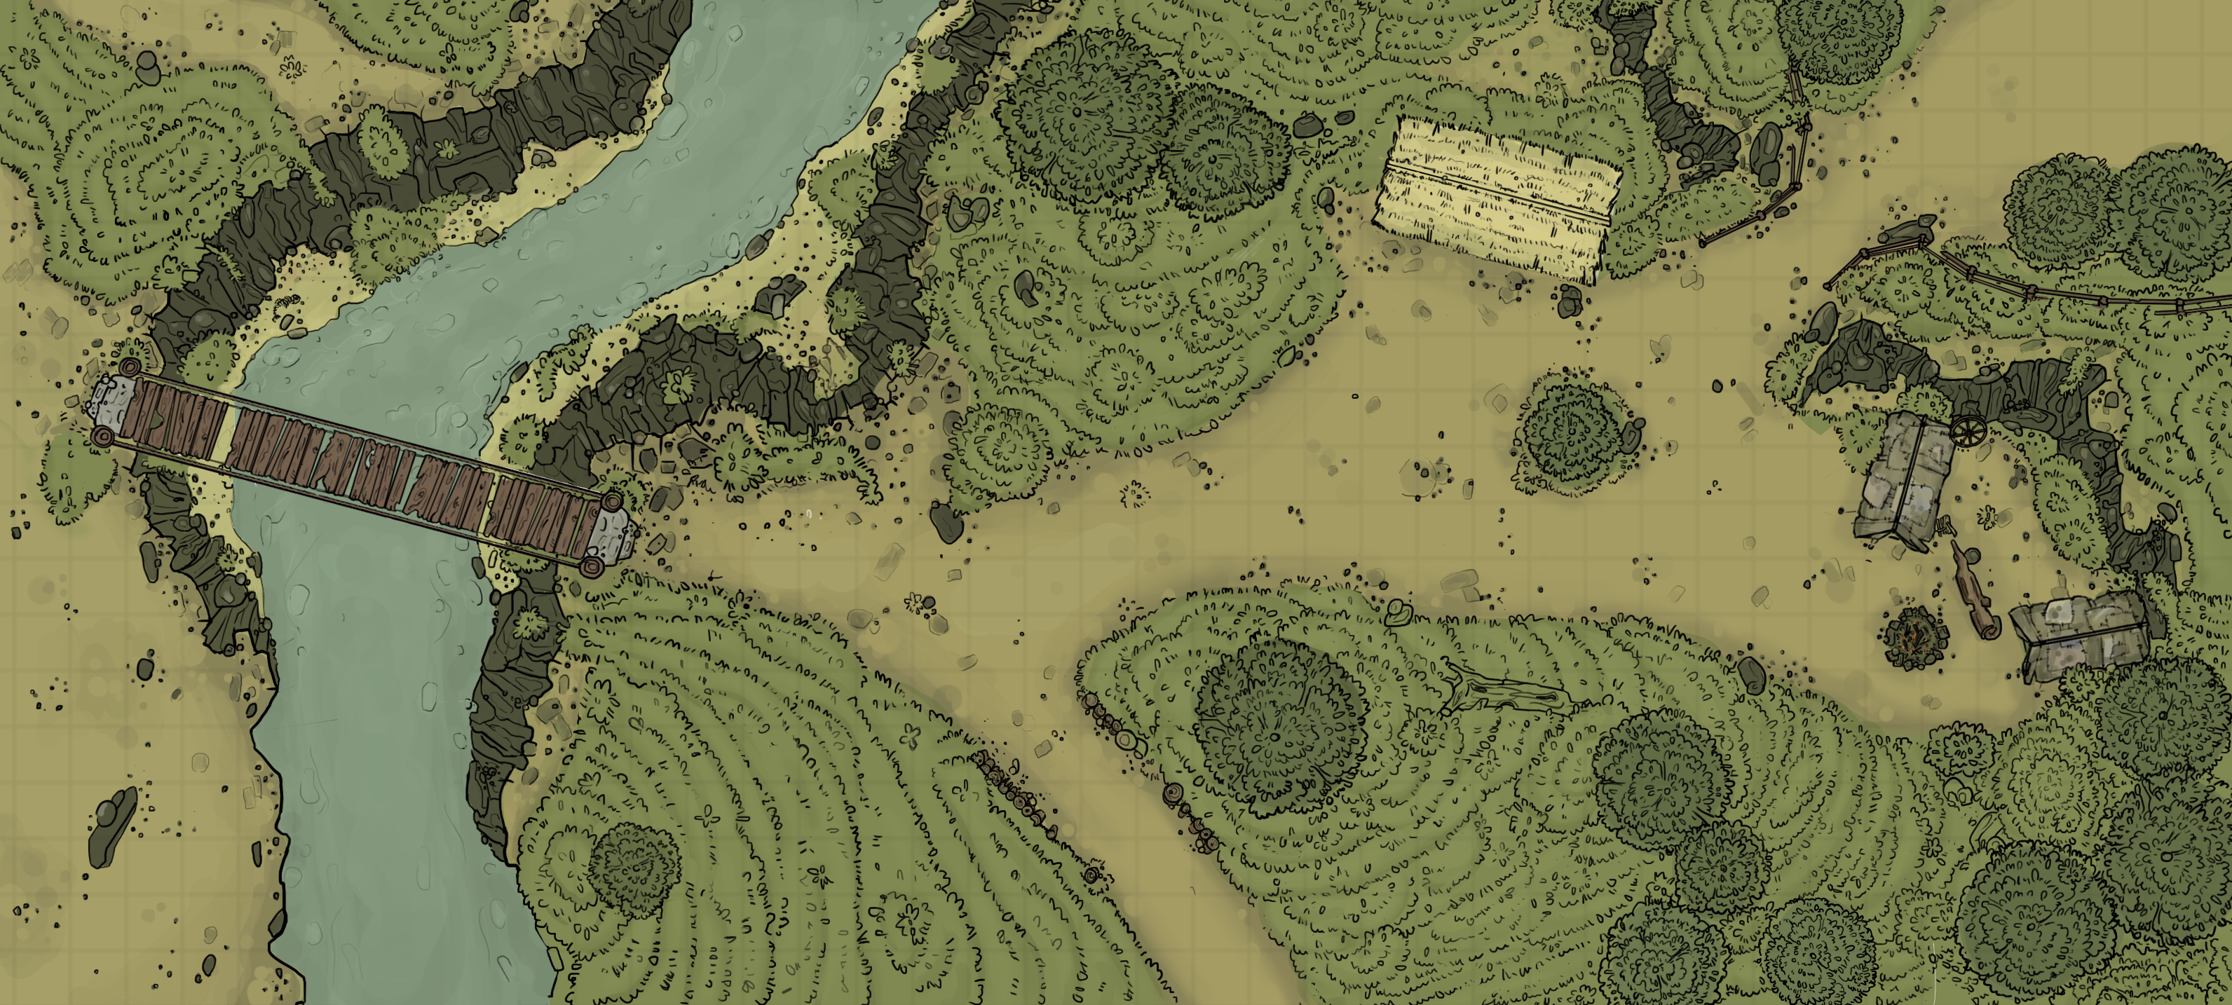
CardGame-Kingdoms
^{C}K^{g}
Online
Offline
Settings
Cards
Exit

Slide 2

Settings
IP:

Slide 3
Online Lobby
^{C}K^{g}
Ready

Slide 4
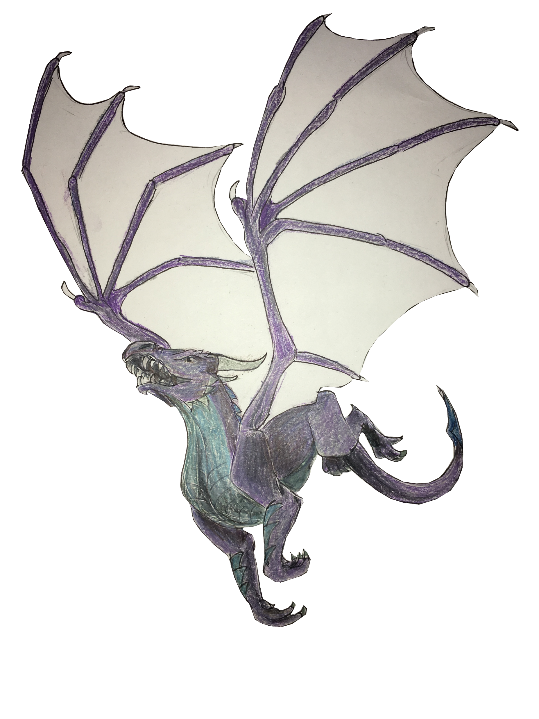

Slide 6
^{C}K^{g}
^{C}K^{g}

Slide 7


